Slide 1

DES646 Project: Deepfake Guard - rPPG-Driven Deepfake Detection System
Group GaurNitai

Slide 2
Team: GaurNitai
Team members:
Bhavya Garg (220296)
2)Sachin Kumhar (230891)
3)Himesh(240456)
4)Abhinav Singhal(210031)
5)Chevva Praneeth(240306)

Slide 3
1. Project Overview & Motivation
With the rapid advancement of AI-generated media, deepfake videos have emerged as a major threat to digital authenticity and information integrity. Deepfake Guard aims to detect and prevent synthetic manipulations in video content through a combination of advanced computer vision, biometric pattern recognition, and behavioral analysis. Our objective is to develop a system that can identify manipulated facial, audio, and environmental cues with high precision.

Slide 4
2. System Design
The system, named Deepfake Guard, employs a multi-layered detection framework integrating three core modules:
1. Dynamic Biometric Interrogation (DBI): Randomized prompts such as 'say a random number while turning your head' are used to analyze real-time facial expression, lip-sync, and attention cues. This unpredictability makes it extremely difficult for deepfake models to generate appropriate responses in real time.
2. Ensemble Detection Model: A combination of facial landmark tracking, lip-audio coherence analysis, and environmental consistency checks to detect possible manipulations.
3. Trust Score Engine: Calculates an authenticity score for every video frame sequence. Based on this score, the system can flag potential deepfakes, request re-verification, or mark the content as authentic.

Slide 5
3. Research Process & Development Journey
Our journey began with a survey of existing deepfake detection models and datasets. We analyzed methods based on convolutional neural networks (CNNs), vision transformers (ViTs), and multimodal approaches combining audio-visual features. We also explored human-centric signals such as micro-expressions and motion prediction errors inspired by cognitive science, leading to the inclusion of the 'Uncanny Valley' hypothesis as part of our detection logic.
As an interdisciplinary team from different academic years, we integrated ideas from machine learning, behavioral science, and visual computing to create a conceptually strong framework. The prototype focuses on algorithmic experimentation and simulation-based testing using publicly available deepfake datasets

Slide 6
4. Role of Course, Mentorship & Resources
This project was developed as part of our course-based AI/ML project work at IIT Kanpur. The course structure, mentorship, and feedback provided by faculty and peers were invaluable in guiding our research direction. We leveraged open-source tools like TensorFlow, PyTorch, OpenCV, and dlib for feature extraction and model training.

Slide 7
5. Learnings, Results & Future Work
Key Learnings: • Deepfake detection benefits from combining machine learning with behavioral and biological cues. • Interdisciplinary research enhances both accuracy and interpretability of AI models. • Real-world data collection and controlled testing are critical for robust evaluation.
Results & Future Work: • Prototype achieved promising preliminary results in distinguishing authentic vs. manipulated frames. • Future work involves extending the system to handle audio-based deepfakes, improving temporal coherence modeling, and integrating our trust scoring framework into a real-time video authentication tool.

Slide 8
6. Closing Reflection
Deepfake Guard represents our collective step toward strengthening digital trust and authenticity. Through this project, we not only deepened our understanding of AI-driven forgery detection but also realized the importance of combining technical rigor with human-centric insight. Our ultimate goal is to contribute to the broader mission of responsible and secure AI applications in society.

Slide 9
Technical Details:
Core Services (Microservices):
DBI Engine: Real-time challenge generation
Biometric Processor: AI/ML analysis pipeline
Trust Score Calculator: Behavioural analytics
Risk Assessment: Fraud detection algorithms
User Experience:
30-second onboarding
95% invisible security
Tech Stack:
Computer Vision: OpenCV, MediaPipe, MTCNN
Deep Learning: TensorFlow, PyTorch, Keras
Audio Processing: Librosa, PyAudio
Behavioral Analytics: scikit-learn, XGBoost
Real-time Processing: Apache Kafka, Redis

Slide 10
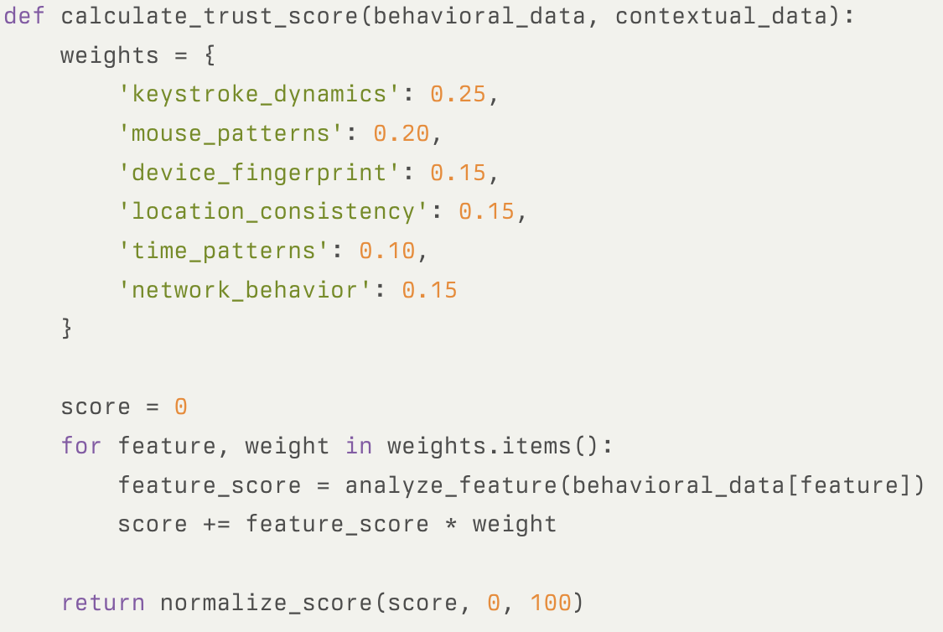
CTS Calculation

Slide 11
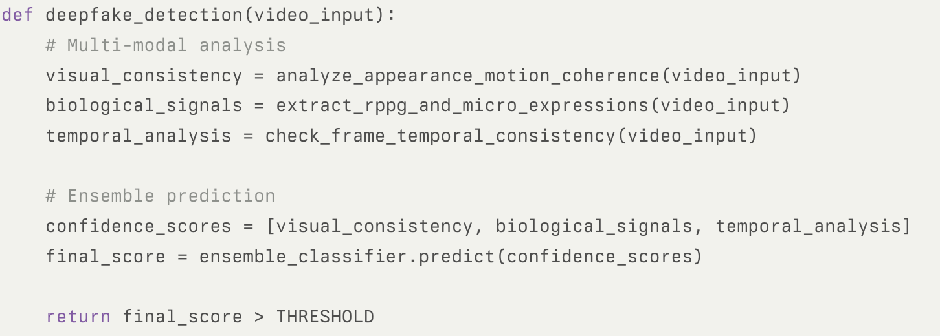
Deepfake Detection Pipeline

Slide 12
Summary
TrustNet 360° is a two-part revolutionary system combining Bio-Metric Genesis (un-spoofable VKYC) with Continuous Trust Assurance (real-time monitoring) to create an unbreakable chain of digital identity trust.
Key innovations:
Dynamic Biometric Interrogation (DBI): Real-time, unpredictable challenges that synthetic media cannot replicate
Multi-Modal Authentication: Heartbeat analysis, micro-expressions, eye tracking, environmental validation
Continuous Trust Score (CTS): 0-100 real-time risk assessment with adaptive security responses
Digital DNA: Unique, encrypted identity signature combining biological and behavioural patterns
Business Impact:
Market: $15B identity verification industry with 22% CAGR
ROI for BoB: 99.5% reduction in deepfake attacks, $50M annual fraud savings
Scalability: B2B SaaS platform serving global financial institutions

